Slide 1
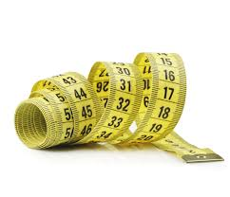
My Shape and Measurement Interactive Notebook
Name
Class
Teacher: Mr Summers
Semester 1
Term 2
1

Slide 2
Contents
Glossary or Formula Page
Page
Date
Description
2
3

Slide 3
Tasks
24
7
30
Essential Question
Questions
Notes
Summary

Slide 4
Question of the Day
What do the United Liberia and Myanmar have in common?
Answer in Video:
http://edition.cnn.com/2015/06/05/opinions/marciano-america-go-metric/index.html

Slide 5
24
7
30
Date
Unit Conversion
EQ – What units of measurement are there and how do I convert between them?
Summary:

Slide 6
We use the metric system to measure units of length, mass and capacity. On the LHS of your INB, write as many of the following:
What units of length do you know?
What units of mass do you know?
What units of capacity do you know?
Summary:

Slide 7
24
7
30
Date
Unit Conversion
EQ – What units of measurement are there and how do I convert between them?
What is a Metric Unit?
Metric units are the universally excepted units around the world. They are the easiest to convert.
Metric Unit Examples:
meters
litres
grams
Key Base Units – all other metric units are based off of these (km, cm, ml, kg)
Summary:

Slide 8
24
7
30
Date
Unit Conversion
EQ – What units of measurement are there and how do I convert between them?
Metric Conversions – The Conversion Caterpillar
LENGTH
Examples:
Convert 3m to cm
3 x 100 = 300cm
Convert 5.7km to m
5.7 x 1000 = 5700m
Convert 3.6km to cm
3.6 x 1000 = 3600m
3600 x 100 = 360000cm
x 1000
x 100
x 10
km
m
cm
mm
÷ 1000
÷ 100
÷ 10

Slide 9
24
7
30
Date
Unit Conversion
EQ – What units of measurement are there and how do I convert between them?
Examples:
Convert 5g to mg
5 x 1000 = 5000mg
Convert 2.9kg to g
2.9 x 1000 = 2900m
Convert 7.6 tonnes to mg
7.6 x 1000 = 7600Kg
7600 x 1000 = 7600000g
7600000 x 1000 = 7600000000mg
MASS
x 1000
x 1000
x 1000
kg
g
mg
Tonne
÷ 1000
÷ 1000
÷ 1000

Slide 10
24
7
30
Date
Unit Conversion
EQ – What units of measurement are there and how do I convert between them?
Examples:
Convert 9l to ml
9 x 1000 = 9000ml
Convert 90ml to l
90 ÷ 1000 = 0.09l
Convert 1.53 kl to ml
1.53 x 1000 = 1530l
1530 x 1000 = 1,530,000 ml
CAPACITY
x 1000
x 100
x 10
kl
l
cl
ml
÷ 1000
÷ 100
÷ 10

Slide 11
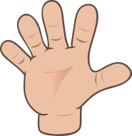
Do you understand? Fists of Five
Notes:
Check for Understanding

Slide 12

Metric Prefixes
Kilo
Hecto Increase to Basic Unit
Deca
Basic Unit (g,m,L)
Deci
Centi Decrease to Basic Unit
Milli

Slide 13
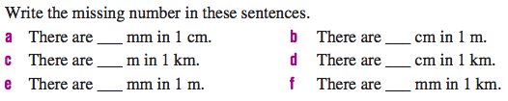
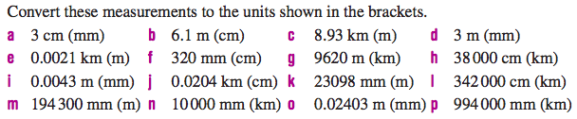
The Fundamentals

Slide 14
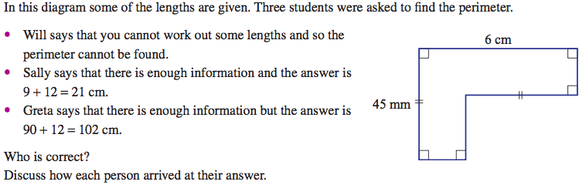
Application

Slide 15

Have YOU been doing your summaries?

Slide 16
24
7
30
Date
Unit Conversion
EQ – What units of measurement are there and how do I convert between them?
Summary:

Slide 17
Notes Review
24, 7 ,30
Date
Title
Essential question
Notes complete
Notes complete with colour and diagrams
Questions completed
Contents page filed in
Formula page filled in

Slide 18
Homework
Review your notes and write a summary answering the essential question.

